Slide 1
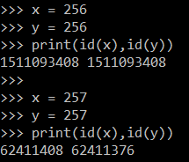
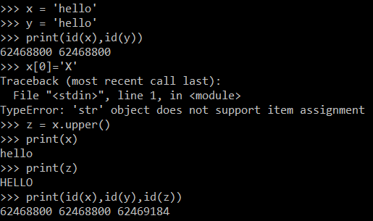
Identity
What can you observe from the following:
Id for numbers > 256 are diff. Numbers and strings are immutable

Slide 2
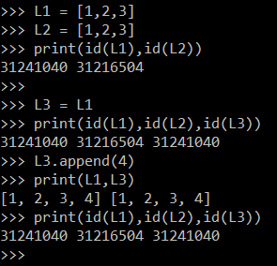
Identity
What can you observe from the following:
List objects are mutable

Slide 3

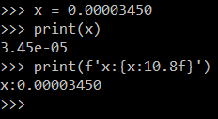
Scientific notation
What can you observe from the following:
As of Python 3, for numbers less than 1e-4 or greater than 1e16, Python will use scientific notation. Otherwise, it uses standard notation.

Slide 4
String Methods
What can you observe from the following:
As of Python 3, for numbers less than 1e-4 or greater than 1e16, Python will use scientific notation. Otherwise, it uses standard notation.

